Slide 1
AutomationArchitecture
Total Overview

Slide 2

Interpretation
CandidateDS
Pulser
Validation
Monitoring
Measurement
RunningDS
OperationalDS
Implementation
CurrentAlarms
(ToDo-List)

Slide 3
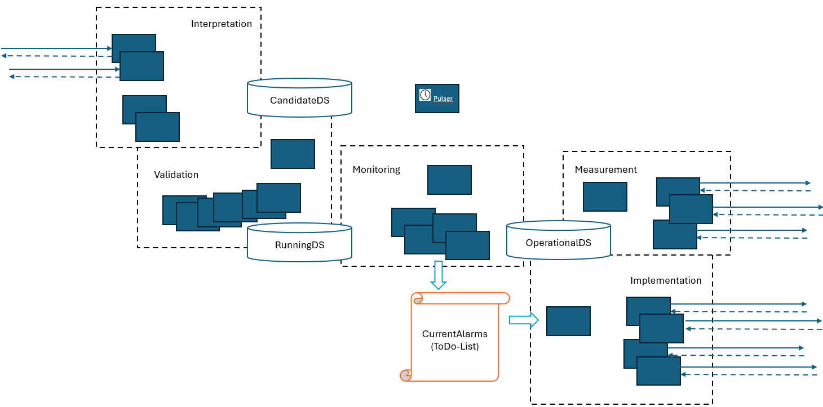

Request gets interpreted:
(deviceGroup y needs firmware z) → association = device x needs firmware z
Request from outside (connect device x to deviceGroup y)
Upon request from outside:
Load CandidateDS into CandidateDS,
Apply desired changes to CandidateDS
Equipment: Actual
FW: Target (desired)
Generic interface to outside
as few info to ouside as possible
Info readable by other domains
OperationalDS only contains data required for managing the domain (state on devices)
Load current equipment + firmware state from devices
(Difficulty: interface is generic, but data is not homogenous → interpretation of data required)
Approval:
All domain rules met?
Only then candidate can transition to target state
Validation checks if changes to CandidateDS are valid, if yes RunningDS is overwritten by CandidateDS content
Target state
Actual state
Equipment: Actual
FW: Target (validated)
Equipment: Actual
FW: Actual
All datastores have same data model, but with different meanings:
Equipment
Firmware
Implementation functions write changes into the network
(RPC1: download of FW to device, RPC2: device unpacks FW)
ToDos = deviation between target and actual state
(RunningDS – OperationalDS)

